Slide 1
SLR (1) Parsing

Slide 2
Shift-Reduce Parsers
There are two main categories of shift-reduce parsers
1. Operator-Precedence Parser
– simple, but only a small class of grammars.
CFG LR LALR
SLR
LR-Parsers
covers wide range of grammars.
SLR – simple LR parser
LR – most general LR parser
LALR – intermediate LR parser (lookhead LR parser)
SLR, LR and LALR work same, only their parsing tables are different.

Slide 3
LR Parsers
LR parsing is attractive because:
LR parsing is most general non-backtracking shift-reduce parsing,
yet it is still efficient.
The class of grammars that can be parsed using LR methods is a proper superset of the class of grammars that can be parsed with predictive parsers.
LL(1)-Grammars ⊂ LR(1)-Grammars
An LR-parser can detect a syntactic error as soon as it is possible to do so a left-to-right scan of the input.
LR parsers can be constructed to recognize virtually all programming language constructs for which CFG grammars can
be written
Drawback of LR method:
Too much work to construct LR parser by hand
Fortunately tools (LR parsers generators) are available

Slide 4
LR Parsing Algorithm
input
stack
a₁ | ... | a_{i} | ... | a_{n} | $
S_{m}
X_{m}
^{S}m-1
^{X}m-1
.
.
S₁
X₁
S₀
LR Parsing Algorithm
output
Action Table terminals and $ |  | Goto Table non-terminal
s t a t e s | four different actions | s t each item is a a state number t e s

Slide 5
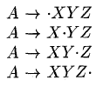
Items and LR(0) Automaton
An LR(0) item of a grammar G is a production of G with a dot in some position in the body . Thus a production A-> XYZ yields the following 4 items:
The production A-> ԑ generates only one item, A->.

Slide 6
LR(0) collection of items
A collection of sets of LR(0) items is called the canonical LR(0) collection
This collection provides the basis for constructing a deterministic finite automaton that is used to make parsing decisions
To construct the canonical LR(0) collection for a grammar , we define an augmented grammar and two functions, CLOSURE and GOTO
If G is a grammar with start symbol S, then G’, the augmented grammar for G, is G with a new start symbol S’ and production S’-> S

Slide 7
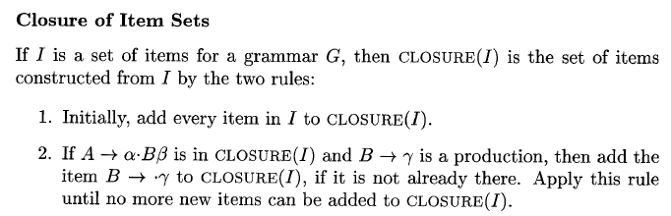
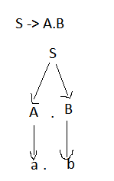
LR(0) collection of items
S -> AB
A -> a
B -> b

Slide 8
LR(0) collection of items
S -> AB
A -> a
B -> b
INSERT B-> .b in CLOSURE

Slide 9
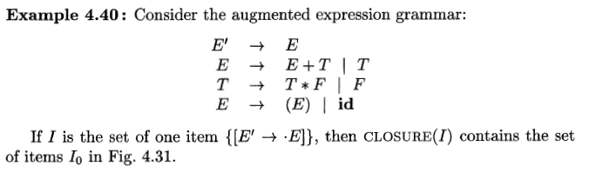
LR(0) collection of items
CLOSURE EXAMPLE:

Slide 10
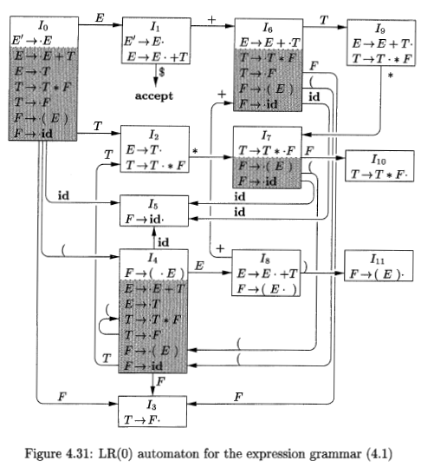
LR(0) collection of items
CLOSURE EXAMPLE:

Slide 11
LR(0) collection of items
GOTO:
Iii
A-> α.Xβ
.
.
.
X
A-> α X.β
.
.
.
I
I’
GOTO (I,X) = I’

Slide 12
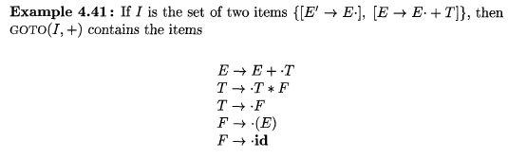
LR(0) collection of items
GOTO EXAMPLE:

Slide 13
LR(0) collection of items
Consider the following grammar:
S-> AB
A-> a
B -> b
Let’s build an LR(0) Automaton for the grammar
First step is to augment the grammar by introducing a new start symbol
S’->S
S-> AB
A-> a
B -> b

Slide 14

LR(0) collection of items
S’-> .S
S-> .AB
A->.a
I0

Slide 15
LR(0) collection of items
S’-> S.
S’-> .S
S-> .AB
A->.a
S
I1
I0

Slide 16
LR(0) collection of items
S’-> S.
S’-> .S
S-> .AB
A->.a
S
I1
A
I0
S-> A.B
B->.b
I2

Slide 17
LR(0) collection of items
S’-> S.
S’-> .S
S-> .AB
A->.a
S
I1
A
I0
S-> A.B
B->.b
a
I2
A->a.
I3

Slide 18
LR(0) collection of items
S’-> S.
S’-> .S
S-> .AB
A->.a
S
I1
S->AB.
B
A
I0
S-> A.B
B->.b
I4
a
I2
A->a.
I3

Slide 19
LR(0) collection of items
S’-> S.
S’-> .S
S-> .AB
A->.a
S
I1
S->AB.
B
A
I0
S-> A.B
B->.b
I4
a
b
I2
B->b.
A->a.
I5
I3

Slide 20
LR Parse table
Now, build SLR(1) Parse table from canonical LR(0) collection of items
Action(i,a) | GOTO(i,A)

Slide 21
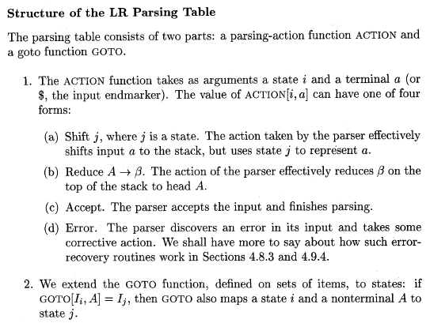
Structure of LR Parsing Table

Slide 22
Building SLR(1) Parse table
Lets see the canonical collection of LR(0) items again

Slide 23
LR(0) collection of items
S’-> S.
S’-> .S
S-> .AB
A->.a
S
I1
S->AB.
B
A
I0
S-> A.B
B->.b
I4
a
b
I2
B->b.
A->a.
I5
I3

Slide 24
SLR (1) parse table
States | ACTION(I,a) |  |  | GOTO (I,A)
 | a | b | $ | S | A | B
0 | s3
1
2 |  | s5
3
4
5

Slide 25
SLR (1) parse table
States | ACTION(I,a) |  |  | GOTO (I,A)
 | a | b | $ | S | A | B
0 | s3 |  |  | 1 | 2
1
2 |  | s5 |  |  |  | 4
3
4
5

Slide 26
SLR(1) PARSE TABLE
Items in reduced form:
0. S’->S.
S-> AB.
A->a.
B->b.

Slide 27
LR(0) collection of items
S’-> S.
S’-> .S
S-> .AB
A->.a
S
I1
S->AB.
B
A
I0
S-> A.B
B->.b
I4
a
b
I2
B->b.
A->a.
I5
I3

Slide 28
SLR(1) PARSE TABLE
Items in reduced form:
0. S’->S.
Follow (S’)={$}
Rule 0 is in state 1, so reduction/ acceptance in state 1

Slide 29
SLR (1) parse table
States | ACTION(I,a) |  |  | GOTO (I,A)
 | a | b | $ | S | A | B
0 | s3 |  |  | 1 | 2
1 |  |  | accept
2 |  | s5 |  |  |  | 4
3
4
5

Slide 30
LR(0) collection of items
S’-> S.
S’-> .S
S-> .AB
A->.a
S
I1
S->AB.
B
A
I0
S-> A.B
B->.b
I4
a
b
I2
B->b.
A->a.
I5
I3

Slide 31
SLR(1) PARSE TABLE
Items in reduced form:
0. S’->S.
Follow (S’)={$}
Rule 0 is reduced in state 1, so reduction/acceptance in state 1
S-> AB.
Follow (S) = {$}
Rule 1 is reduced in state 4, so reduction by rule 1 in state 4

Slide 32
SLR (1) parse table
States | ACTION(I,a) |  |  | GOTO (I,A)
 | a | b | $ | S | A | B
0 | S3 |  |  | 1 | 2
1 |  |  | accept
2 |  | S5 |  |  |  | 4
3
4 |  |  | R1
5

Slide 33
LR(0) collection of items
S’-> S.
S’-> .S
S-> .AB
A->.a
S
I1
S->AB.
B
A
I0
S-> A.B
B->.b
I4
a
b
I2
B->b.
A->a.
I5
I3

Slide 34
SLR(1) PARSE TABLE
Items in reduced form:
2. A-> a.
Follow (A)={b}
Rule 2 is reduced in state 3, so reduction by rule 2 in state 3

Slide 35
SLR (1) parse table
States | ACTION(I,a) |  |  | GOTO (I,A)
 | a | b | $ | S | A | B
0 | S3 |  |  | 1 | 2
1 |  |  | accept
2 |  | S5 |  |  |  | 4
3 |  | R2
4 |  |  | R1
5

Slide 36
LR(0) collection of items
S’-> S.
S’-> .S
S-> .AB
A->.a
S
I1
S->AB.
B
A
I0
S-> A.B
B->.b
I4
a
b
I2
B->b.
A->a.
I5
I3

Slide 37
SLR(1) PARSE TABLE
Items in reduced form:
3. B->b.
Follow (B)={$}
Rule 3 is reduced in state 5 , so reduction by rule 3 in state 5

Slide 38
SLR (1) parse table
States | ACTION(I,a) |  |  | GOTO (I,A)
 | a | b | $ | S | A | B
0 | S3 |  |  | 1 | 2
1 |  |  | accept
2 |  | S5 |  |  |  | 4
3 |  | R2
4 |  |  | R1
5 |  |  | R3

Slide 39

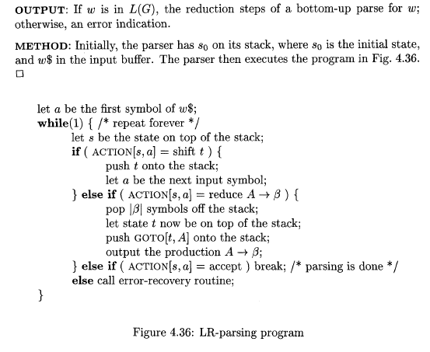
SLR PARSING USING PARSE TABLE

Slide 40
Output of SLR(1) parser on “ab$”
Stack | Input | Action
0 | a b $

Slide 41
SLR (1) parse table
States | ACTION(I,a) |  |  | GOTO (I,A)
 | a | b | $ | S | A | B
0 | S3 |  |  | 1 | 2
1 |  |  | accept
2 |  | S5 |  |  |  | 4
3 |  | R2
4 |  |  | R1
5 |  |  | R3

Slide 42
Output of SLR(1) parser on “ab$”
Stack | Input | Action
0 | a b $ | Shift to 3

Slide 43
SLR PARSING USING PARSE TABLE

Slide 44
Output of SLR(1) parser on “ab$”
Stack | Input | Action
0 | a b $ | Shift to 3
0 3 | a b $

Slide 45
SLR (1) parse table
States | ACTION(I,a) |  |  | GOTO (I,A)
 | a | b | $ | S | A | B
0 | S3 |  |  | 1 | 2
1 |  |  | accept
2 |  | S5 |  |  |  | 4
3 |  | R2
4 |  |  | R1
5 |  |  | R3

Slide 46
Output of SLR(1) parser on “ab$”
Stack | Input | Action
0 | a b $ | Shift to 3
0 3 | a b $ | Reduce using A->a

Slide 47
SLR PARSING USING PARSE TABLE

Slide 48
Action (3,b) = Reduce using Rule 2
= Reduce using A->a
Pop |a|=1 symbol off the stack, 3 gets popped off
Let state t=0 be the top of stack
Push GOTO (t,A)= GOTO(0,A)= 2 onto stack

Slide 49
Output of SLR(1) parser on “ab$”
Stack | Input | Action
0 | a b $ | Shift to 3
0 3 | a b $ | Reduce using A->a
0 2 | a b $

Slide 50
SLR (1) parse table
States | ACTION(I,a) |  |  | GOTO (I,A)
 | a | b | $ | S | A | B
0 | S3 |  |  | 1 | 2
1 |  |  | accept
2 |  | S5 |  |  |  | 4
3 |  | R2
4 |  |  | R1
5 |  |  | R3

Slide 51
Output of SLR(1) parser on “ab$”
Stack | Input | Action
0 | a b $ | Shift to 3
0 3 | a b $ | Reduce using A->a
0 2 | a b $ | Shift to 5

Slide 52
SLR PARSING USING PARSE TABLE

Slide 53
Output of SLR(1) parser on “ab$”
Stack | Input | Action
0 | a b $ | Shift to 3
0 3 | a b $ | Reduce using A->a
0 2 | a b $ | Shift to 5
0 2 5 | a b $

Slide 54
SLR (1) parse table
States | ACTION(I,a) |  |  | GOTO (I,A)
 | a | b | $ | S | A | B
0 | S3 |  |  | 1 | 2
1 |  |  | accept
2 |  | S5 |  |  |  | 4
3 |  | R2
4 |  |  | R1
5 |  |  | R3

Slide 55
Output of SLR(1) parser on “ab$”
Stack | Input | Action
0 | a b $ | Shift to 3
0 3 | a b $ | Reduce using A->a
0 2 | a b $ | Shift to 5
0 2 5 | a b $ | Reduce using B->b

Slide 56
SLR PARSING USING PARSE TABLE

Slide 57
Action (5,$) = Reduce using Rule 3
= Reduce using B->b
Pop |b|=1 symbol off the stack, 3 gets popped off
Let state t=2 be the top of stack
Push GOTO (t,A)= GOTO(2,B)= 4 onto stack

Slide 58
Output of SLR(1) parser on “ab$”
Stack | Input | Action
0 | a b $ | Shift to 3
0 3 | a b $ | Reduce using A->a
0 2 | a b $ | Shift to 5
0 2 5 | a b $ | Reduce using B->b
0 2 4 | a b $

Slide 59
SLR (1) parse table
States | ACTION(I,a) |  |  | GOTO (I,A)
 | a | b | $ | S | A | B
0 | S3 |  |  | 1 | 2
1 |  |  | accept
2 |  | S5 |  |  |  | 4
3 |  | R2
4 |  |  | R1
5 |  |  | R3

Slide 60
Output of SLR(1) parser on “ab$”
Stack | Input | Action
0 | a b $ | Shift to 3
0 3 | a b $ | Reduce using A->a
0 2 | a b $ | Shift to 5
0 2 5 | a b $ | Reduce using B->b
0 2 4 | a b $ | Reduce using S->AB

Slide 61
SLR PARSING USING PARSE TABLE

Slide 62
Action (4,$) = Reduce using Rule 1
= Reduce using S-> AB
Pop |AB|=2 symbol off the stack, 3 gets popped off
Let state t=0 be the top of stack
Push GOTO (t,A)= GOTO(0,S)= 1 onto stack

Slide 63
Output of SLR(1) parser on “ab$”
Stack | Input | Action
0 | a b $ | Shift to 3
0 3 | a b $ | Reduce using A->a
0 2 | a b $ | Shift to 5
0 2 5 | a b $ | Reduce using B->b
0 2 4 | a b $ | Reduce using S->AB
0 1 | a b $

Slide 64
SLR (1) parse table
States | ACTION(I,a) |  |  | GOTO (I,A)
 | a | b | $ | S | A | B
0 | S3 |  |  | 1 | 2
1 |  |  | accept
2 |  | S5 |  |  |  | 4
3 |  | R2
4 |  |  | R1
5 |  |  | R3

Slide 65
SLR PARSING USING PARSE TABLE

Slide 66
Output of SLR(1) parser on “ab$”
Stack | Input | Action
0 | a b $ | Shift to 3
0 3 | a b $ | Reduce using A->a
0 2 | a b $ | Shift to 5
0 2 5 | a b $ | Reduce using B->b
0 2 4 | a b $ | Reduce using S->AB
0 1 | a b $ | accept

